Slide 1
Reframing Liaisonship: Moving Towards Quality User Engagement
Eric Resnis
Jennifer Natale

Slide 2
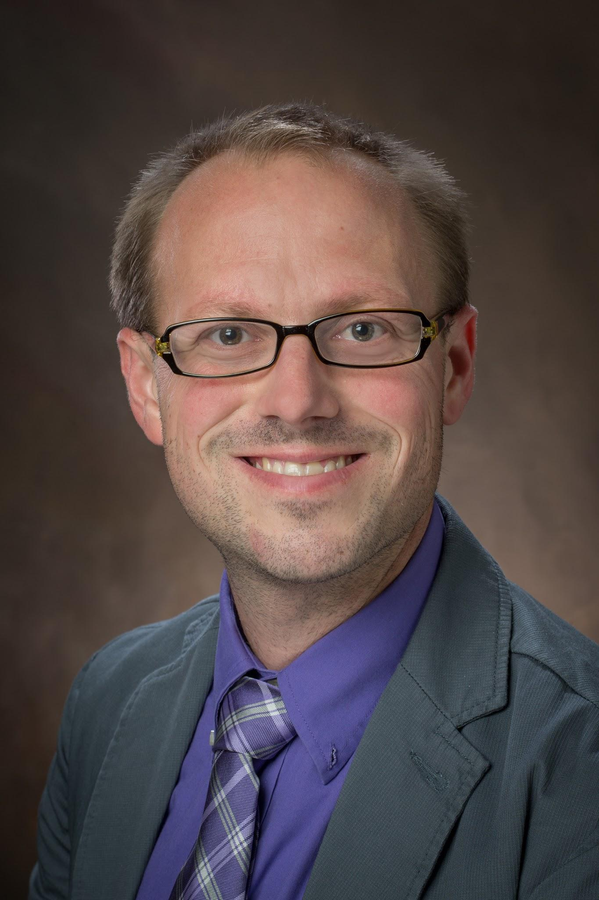
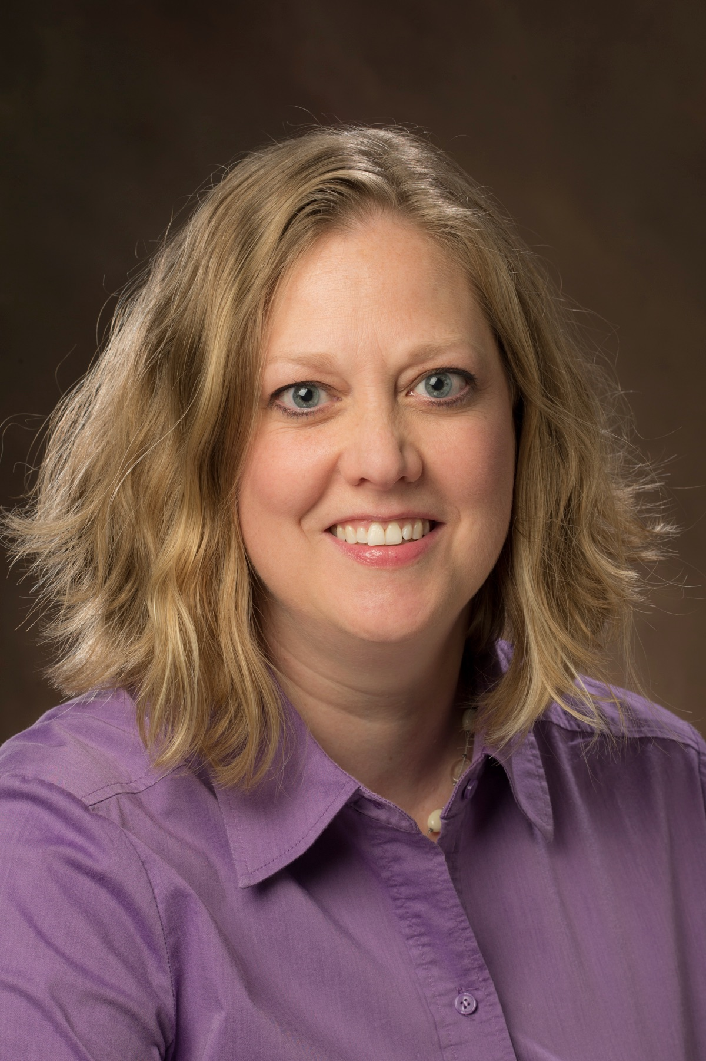
Who We Are
Eric Resnis
Organizational Effectiveness Coordinator
Jennifer Natale
Liaison Librarian; Appalachian State University
Formerly Engagement Librarian; Miami University

Slide 3
Find Your Post-it!
When you think of library LIAISON, what is the FIRST word that comes to mind?
Write it on the post-it!

Slide 4


Slide 5
Turning This Into A Framework
Step 1: What is out there Already?
>> Other Libraries
  Duke’s “Engaging with Library Users...” (2011)
>> Pubs on Models, Assessment
  Facilitator Model (Crossno, et al., 2012)
  Mack and White Assessing Liaison Librarians (ACRL, 2014)
>> Concurrent Conversations
  ARL Library Liaison Institute (2015)

Slide 6
Turning This Into A Framework
Step 2: What Makes Sense For Us?
>> Assumes Same Model
Core Elements (Coll Mgmt, Teaching/Learning, Research,
Engagement) for a specific department or entity
>> Defines Roles for ‘Functional Liaisons’
>> Address Collaboration between Subject Specialists and
Functional Liaisons

Slide 7
So...What DOES it mean?
Liaison: A librarian who is assigned primary engagement responsibility to specific university department(s), program(s), and/or unit(s).
Subject-Specialist: A librarian with additional knowledge in a specific cognate area, who is assigned liaison duties in-part based on that subject knowledge.
Functional Liaison: A librarian who oversees a certain function of the Libraries’ mission such as scholarly communication, digital scholarship, or student engagement. This involves interaction with a wide range of constituents, and often necessitates collaboration with subject-specialists.
Constituent Group: A group of library stakeholders to which a liaison is assigned.

Slide 8
Turning This Into A Framework
Step 3: Assessment First(ish)
>> How is a liaison effective?
>> Impact focused
>> Proactive focused

Slide 9
Liaison Assessment
Internal (As Part of Annual Report and P/T Process)
External (Programmatic)
Data Streams TOGETHER create a holistic view of effective liaisonship

Slide 10
External Programmatic Assessment
Faculty/Administrative Staff Survey
⋩20% Sample
Brief Online Survey
  Awareness
  Interaction
  Value
  Comments for Improvement

Slide 11
Internal Assessment -- Evidence
In conjunction with P/T reporting
Data Collection
  Statistics (Engagement, Instructional)
  Curriculum/Lesson Plans
  Teaching Portfolios
  Collection(s) Data and Analysis
  Transcripts
  Evidence of Departmental Impact

Slide 12
Internal Assessment -- Evaluation
Two foci: Impact and Proactivity
Not the focus: Quantity
Three Gradations of Quality
  Base Level; Good; Better

Slide 13
What does this look like? (Coll Mgmt)
Expectation | Base Level | Good | Better | Evidence
Utilize collection statistics to manage and maintain collections that are relevant to library space requirements. | Management only occurs via required initiatives (zero growth, planned weeding). | Utilize statistics regularly to maintain collections regardless of required initiatives. | Utilizes statistics from multiple sources (consortium, cooperative development) to make decisions about collection management at a more holistic level. | *Collection Data *Collection Plans

Slide 14
What Does This Look Like? (Engagement)
Expectation | Base Level | Good | Better | Evidence
Gain, share, and utilize expertise regarding an area’s curriculum, research, and programs. | Have a basic understanding of departmental offerings and research projects. | Work regularly with faculty and students via instruction, research assistance, and other academic interactions. | Proactively work with department regarding curricular changes and impacts on library resources/services. | *Engagement Statistics *Evidence of departmental impact

Slide 15
What Does This Look Like? (Dig Scholarship)
Expectation | Base Level | Good | Better | Evidence
Collaborate with CDS librarians on projects pertaining to digital scholarship, such as faculty research and visualization projects and student journals. | Collaborates reactively. (Approached by CDS Librarian to participate.) | Regularly works to connect faculty with CDS Librarians. | In conjunction with CDS Librarians, devises projects to connect faculty with each other. | *Engagement Data *Project synopses

Slide 16
The Essentials
Common Understanding of Liaisonship
Can Differ Widely Depending on Institution Size, Mission, Service Models
Should Mesh with Performance Standards
  ⬆ Measureable ⬆
Assessment
  Does it Drive the Process?

Slide 17
Reframing Liaisonship: Moving Towards Quality User Engagement
Eric Resnis
Jennifer Natale

